Slide 1

High Days and Holidays

Slide 2
Index
Band
Genre
Research and Influences
Story
Locations
Budget
Equipment

Slide 3
Finding a client
bandcamp.com
Unsigned.com
Facebook.com - Paige
Instagram – Charlie Hole

Slide 4
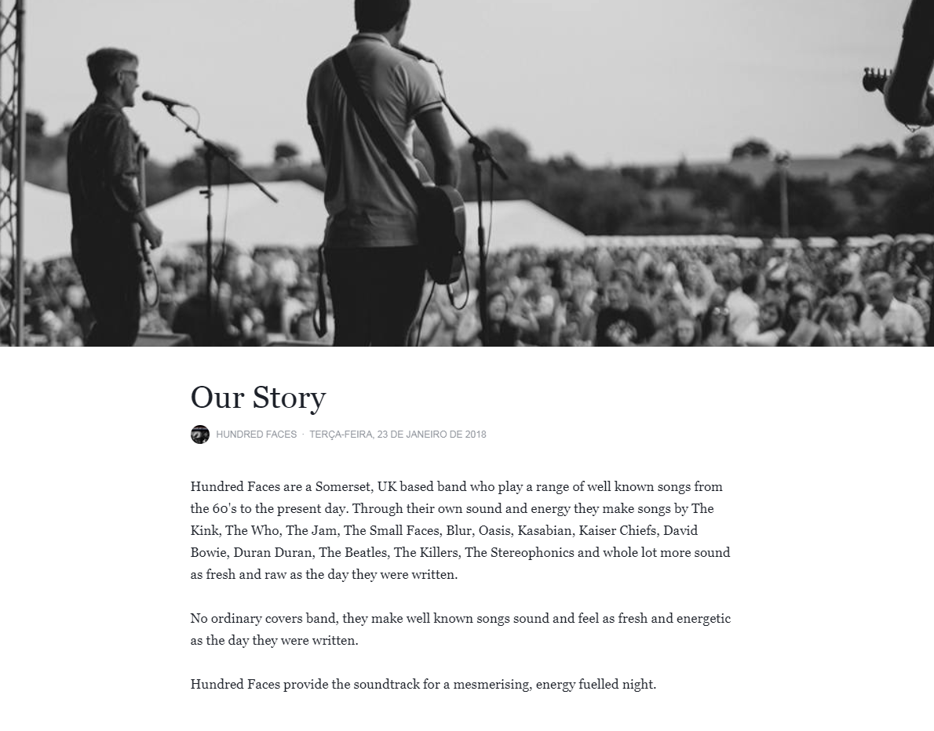
Hundred Faces
Indie Rock

Slide 5
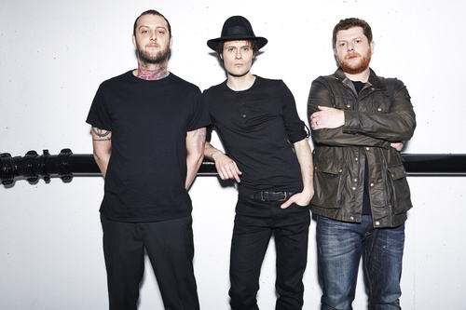
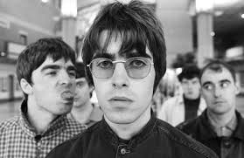
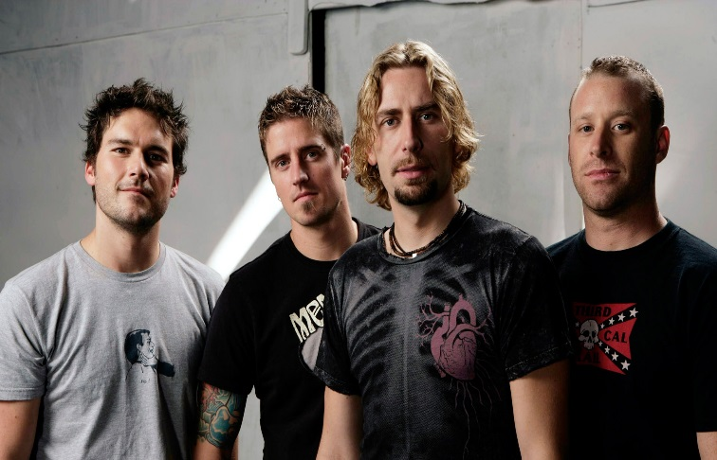
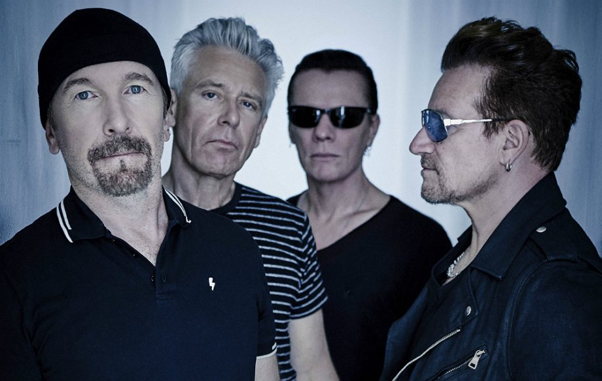
Research
Oasis
The Frattelis
U2
Nickelback

Slide 6
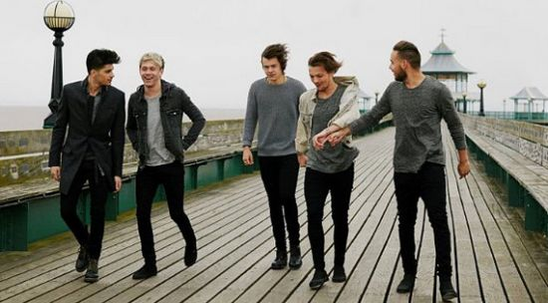
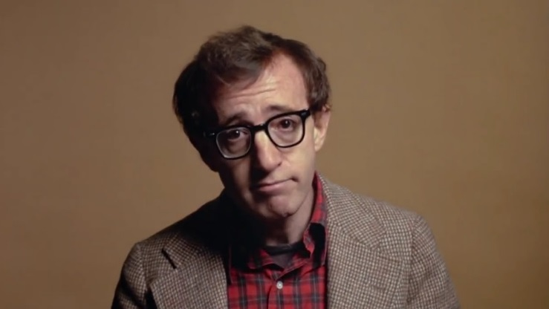
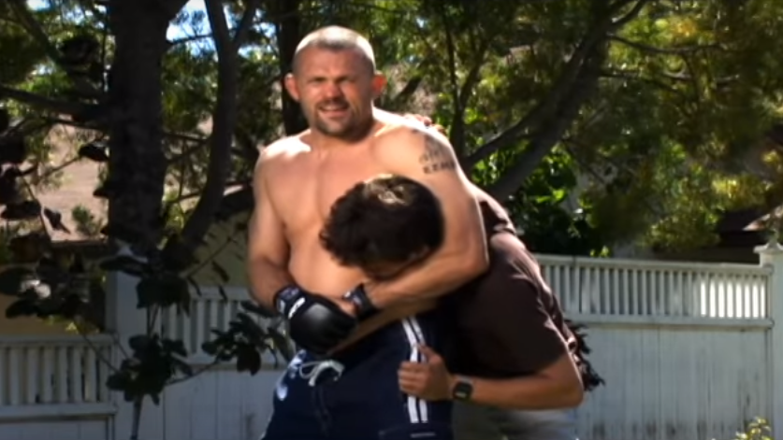
Experiments
Pier
College & Tesco
Studio
One Direction – You & I
Annie Hall – Woody Allen
Nickelback - Rockstar

Slide 7
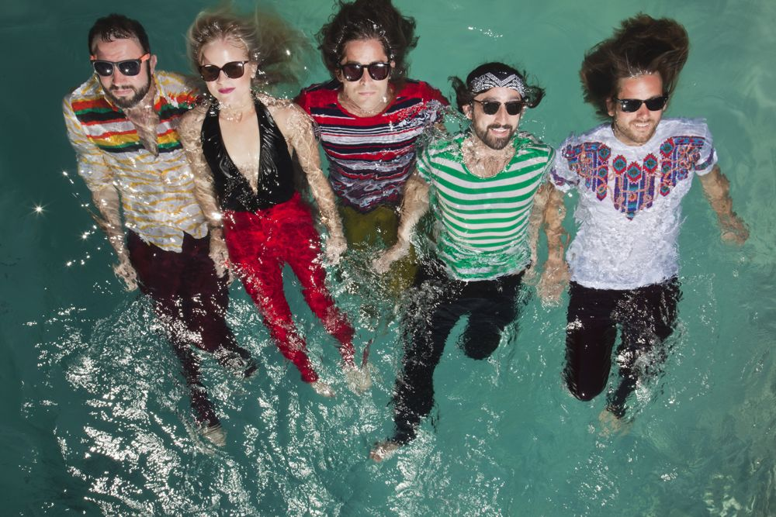

Story
Teenagers
Summer
Holidays
Roadtrip
Inspired by
https://www.youtube.com/watch?v=6ECw5DTULQ8

Slide 8
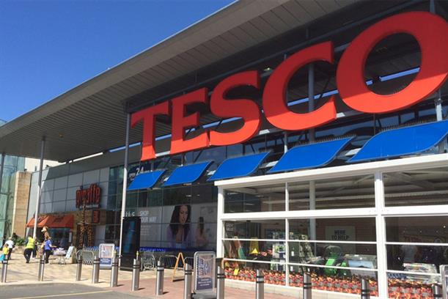
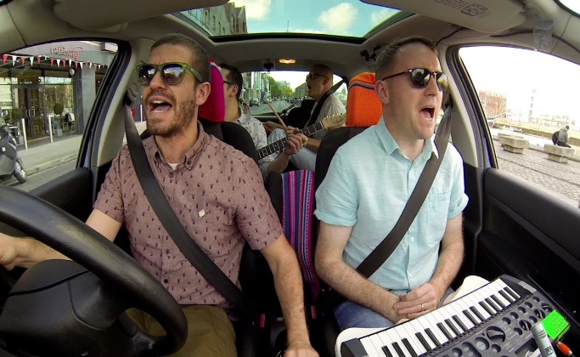
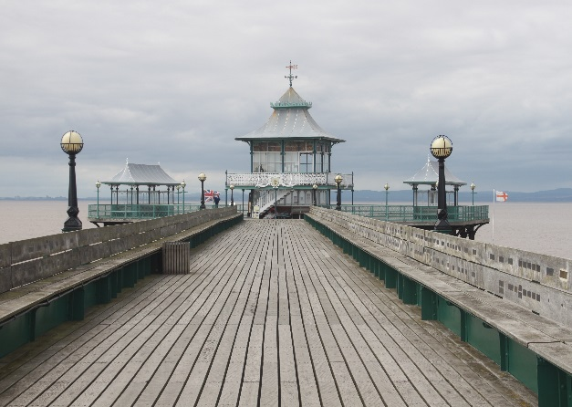
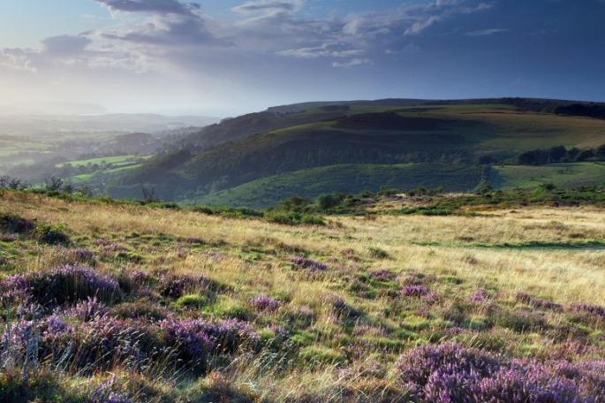
Locations
Testing locations
Final

Slide 9
Equipment
Canon 750D
Sony A6000
Lumix G7
Cars
Skates

Slide 10
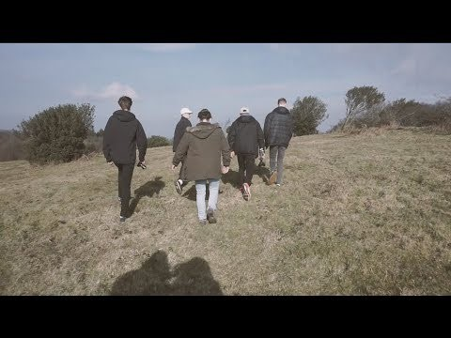
Final Product

